Slide 1
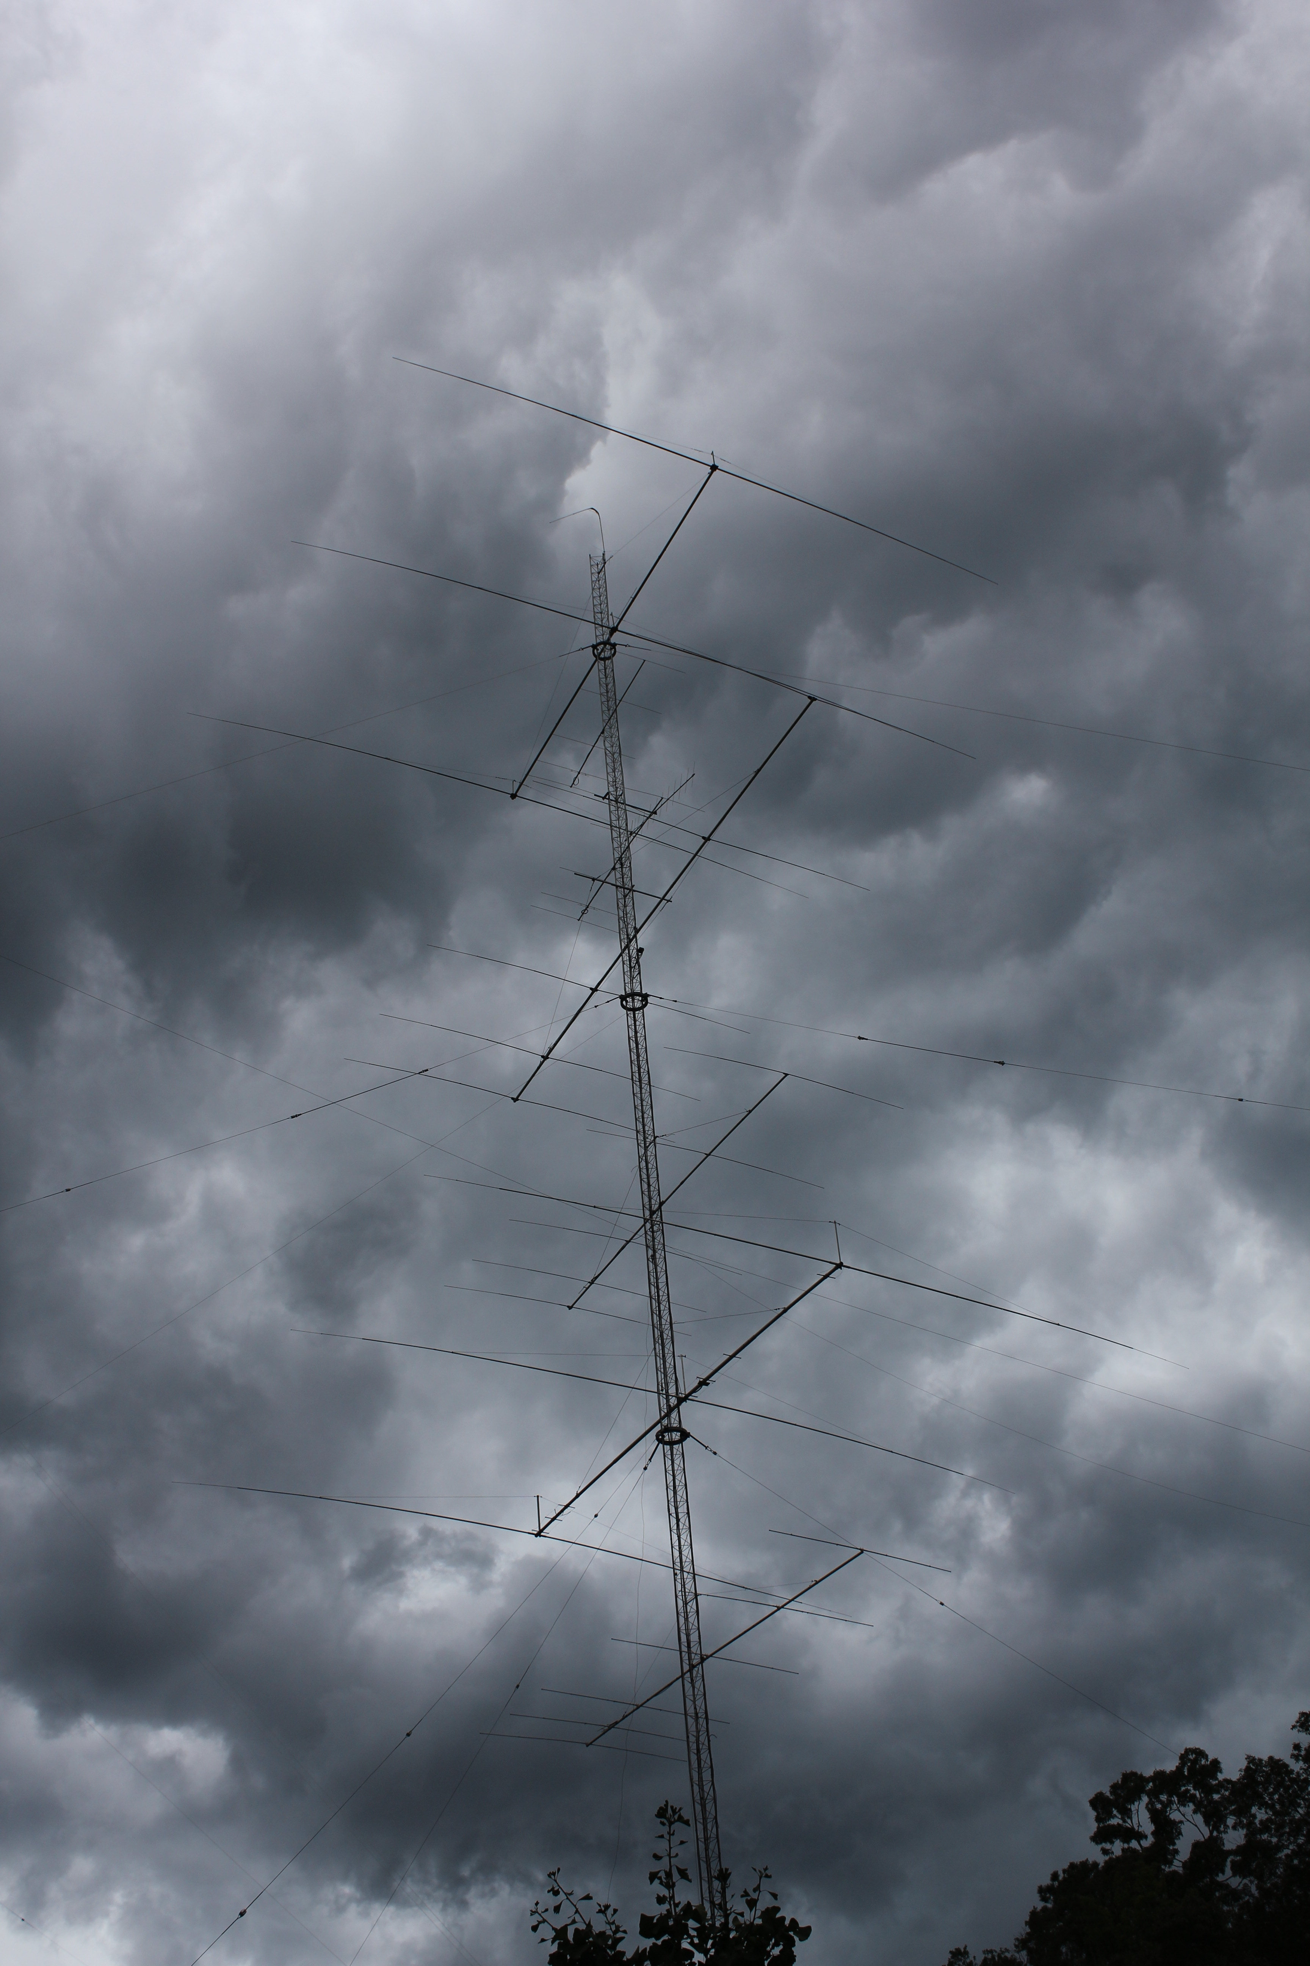
STATION GROUNDING
By W8JI Tom

Slide 2

Two Basic Types of Grounds
RF and signal grounds
  Give antennas or equipment a low impedance signal ground
  Give Marconi antennas something to “push against” (the other missing load terminal)
Lightning and Safety Grounds
  Prevent or minimize shock hazard
  Provide an earth path for lightning
This deals mostly with lightning and safety, but good lightning grounds help with RF problems

Slide 3

Ground = Electrical Mass
A ground usually refers to a large “electrical mass”
This “electrical mass” has an abundance of neutral or balanced charges
An ideal ground has so much “electrical mass” it can supply or absorb balancing charges or currents without greatly changing electrical potential at the ground terminal
A heat sink is to heat as a ground system is to charges

Slide 4

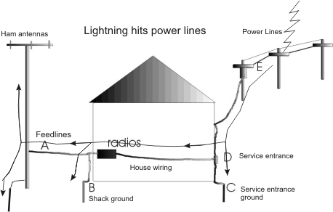
Power Line Strike Damage

Slide 5

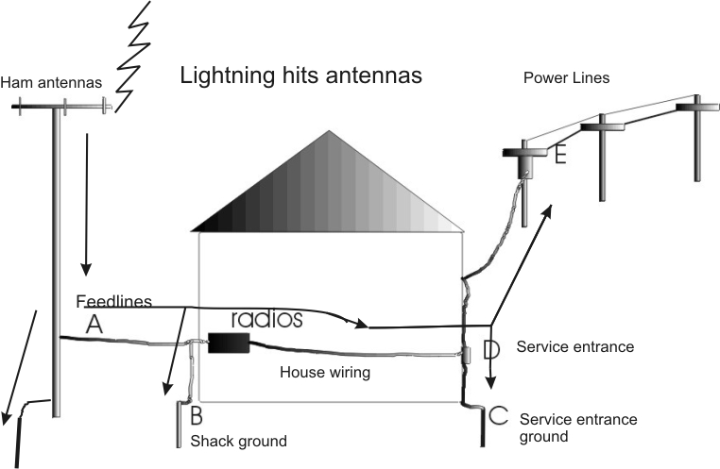
Antenna Strike Damage

Slide 6

Most Common Ground Mistake
Shack ground should always be connected to power mains ground rod with low impedance
  Not connecting together can even increase danger over no ground at all
  This is a national fire safety code, and why all CATV, Telco, and power mains are at one point!
  Ideally all wires and cables should enter at same point of the dwelling, and share a common grounding terminal

Slide 7
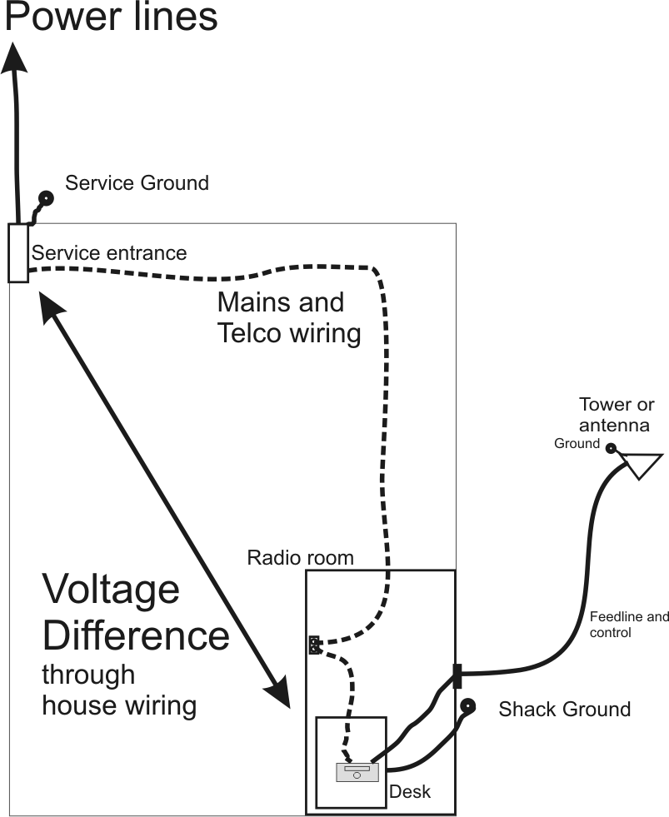
Potential difference between grounds causes current to flow in one entrance and out the other. Flows through equipment, desk area, and house wiring.

Slide 8
Bonded Entrances
The better all wire and cable entrances are bonded, the less important grounds become
This is because most of the current stays outside the equipment

Slide 9
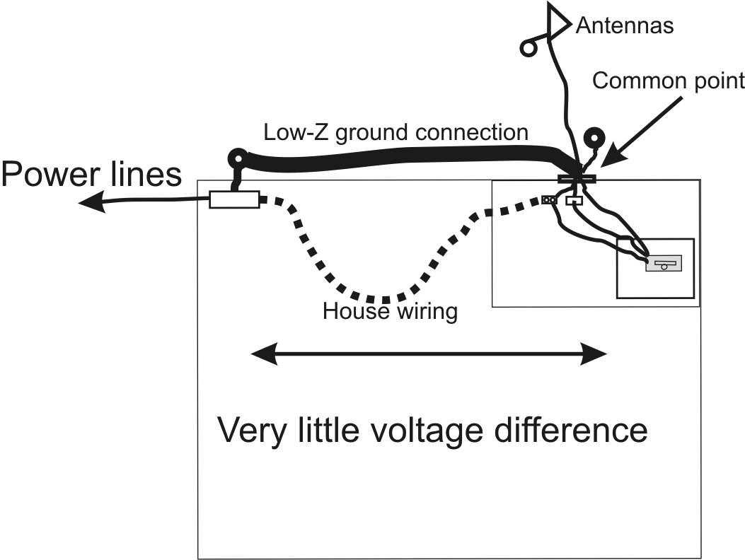
Proper Grounding Method

Slide 10
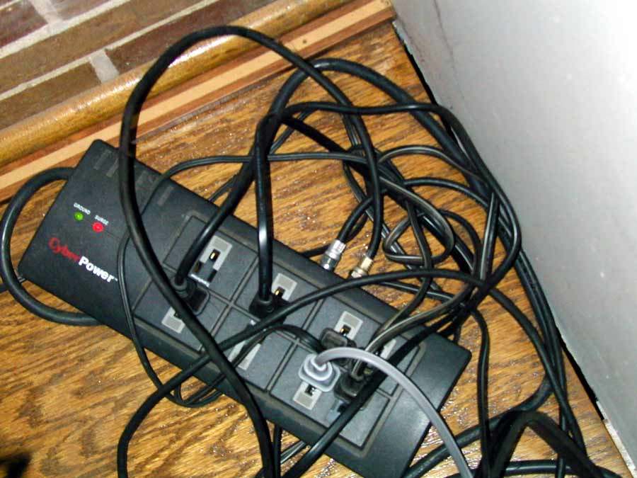
Everything entering or leaving the TV set and stereo comes from one outlet
The antenna system grounds there also
This reduces TVI and RFI as well as lightning
Never any damage to entertainment equipment from strikes

Slide 11
Radio Room Wiring
Most lightning energy and all unwanted RF energy is common mode on wires and cables.
  Damaging currents are mostly on outside of shielded cables or parallel on all conductors of unshielded lines
  Most voltage difference and current flow is between building wire or cable entrances, between isolated grounds, or between different “electrical masses”
  A dipole insulated from ground can still be an electrical mass, and it is a different mass than earth or power lines

Slide 12
Lightning Arrestor
Because most damage is from common mode “shield current”:
  Most protection from lightning arrestor is from the grounding of the shield
      belongs at house entrance
  Ground only helps when arrestor ground is bonded to power mains ground
  An isolated ground at the house can make things worse

Slide 13
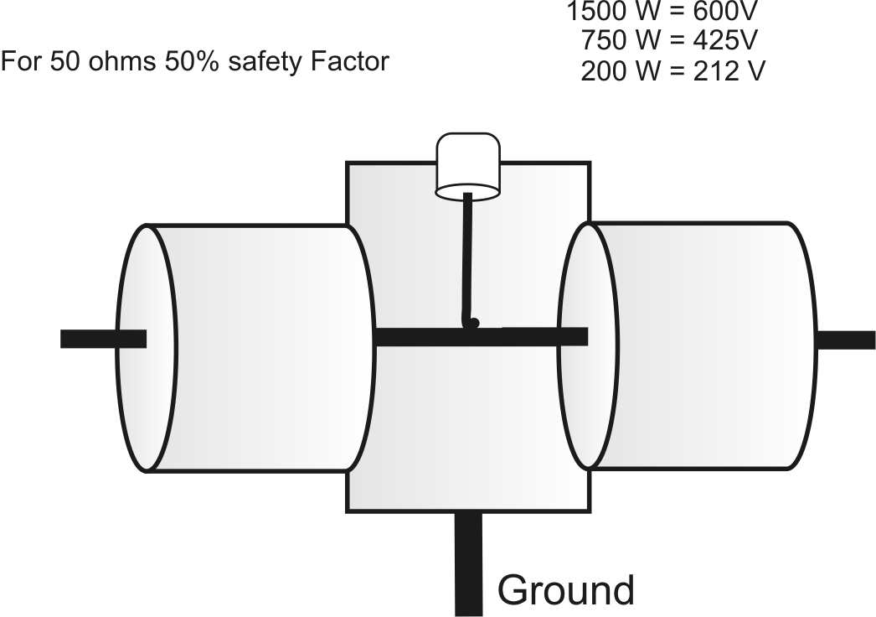
Lightning Arrestor

Slide 14
Lightning Arrestor Use
Use in low SWR systems only!
  Never use with high SWR
  False triggering can damage amplifiers and tuners
Will not protect higher power systems nearly as well as disconnect
  At 1500 watts will pass several hundred volts
  Even at 200 watts, will pass over 200 volts
  Best for protecting very low power systems

Slide 15

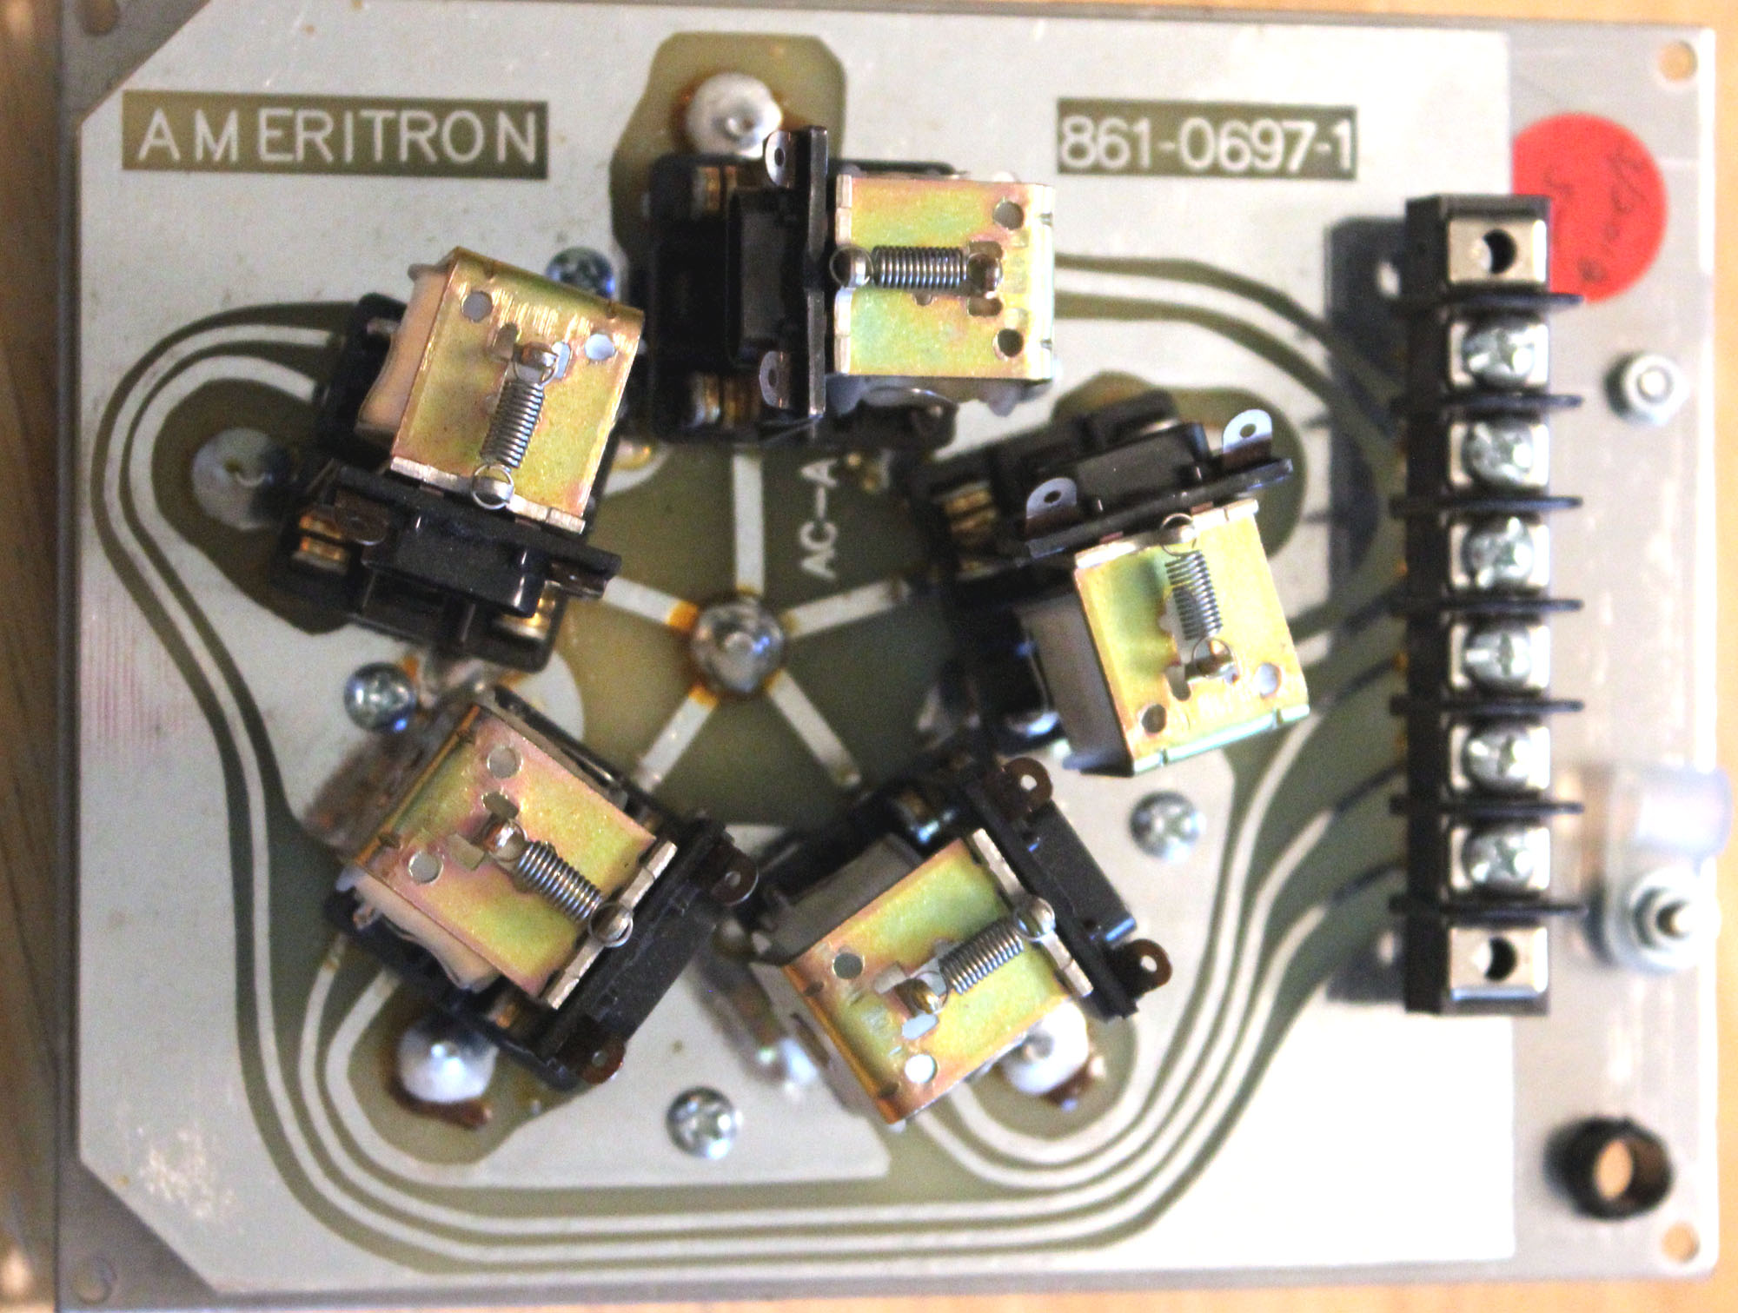
Best Protection on Coaxial Lines

Slide 16

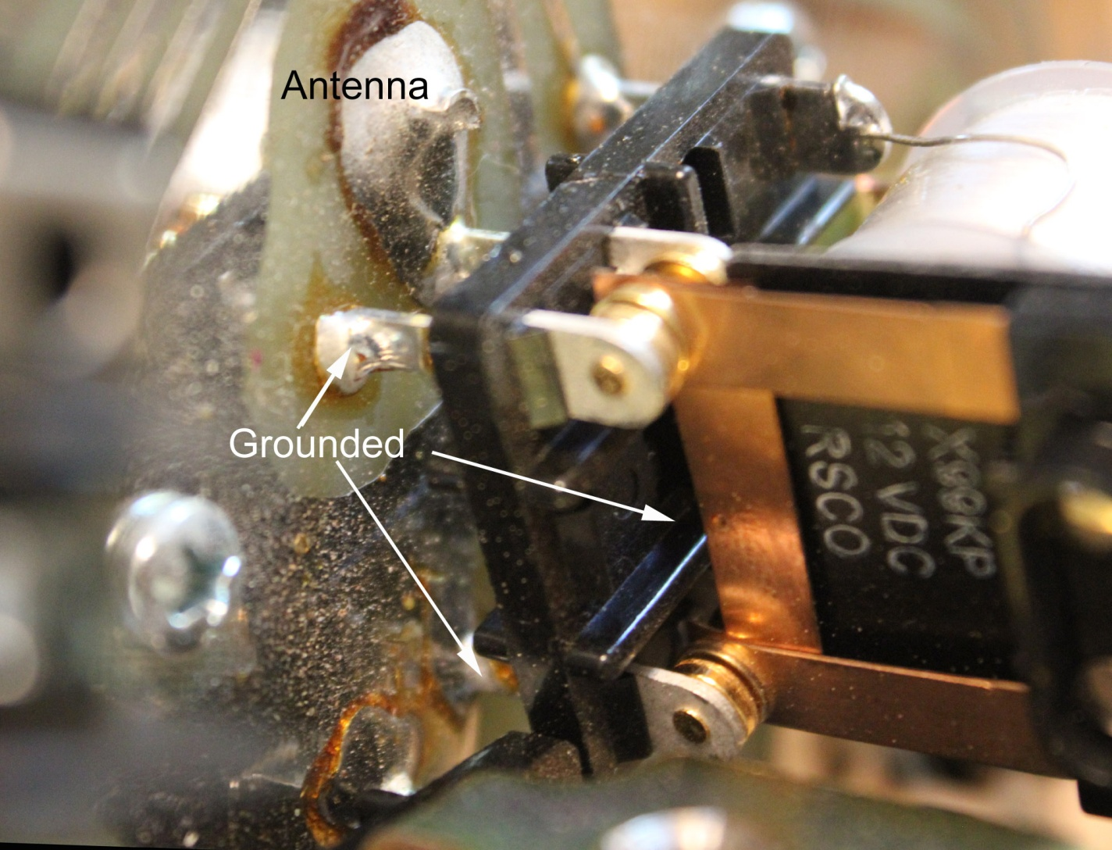
Isolates center conductor when off
Grounds shield at all times
The most center can do, when off, is arc to ground

Slide 17
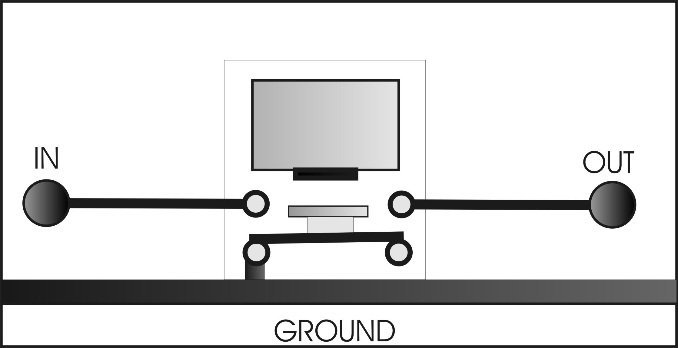
RCS-8V path

Slide 18
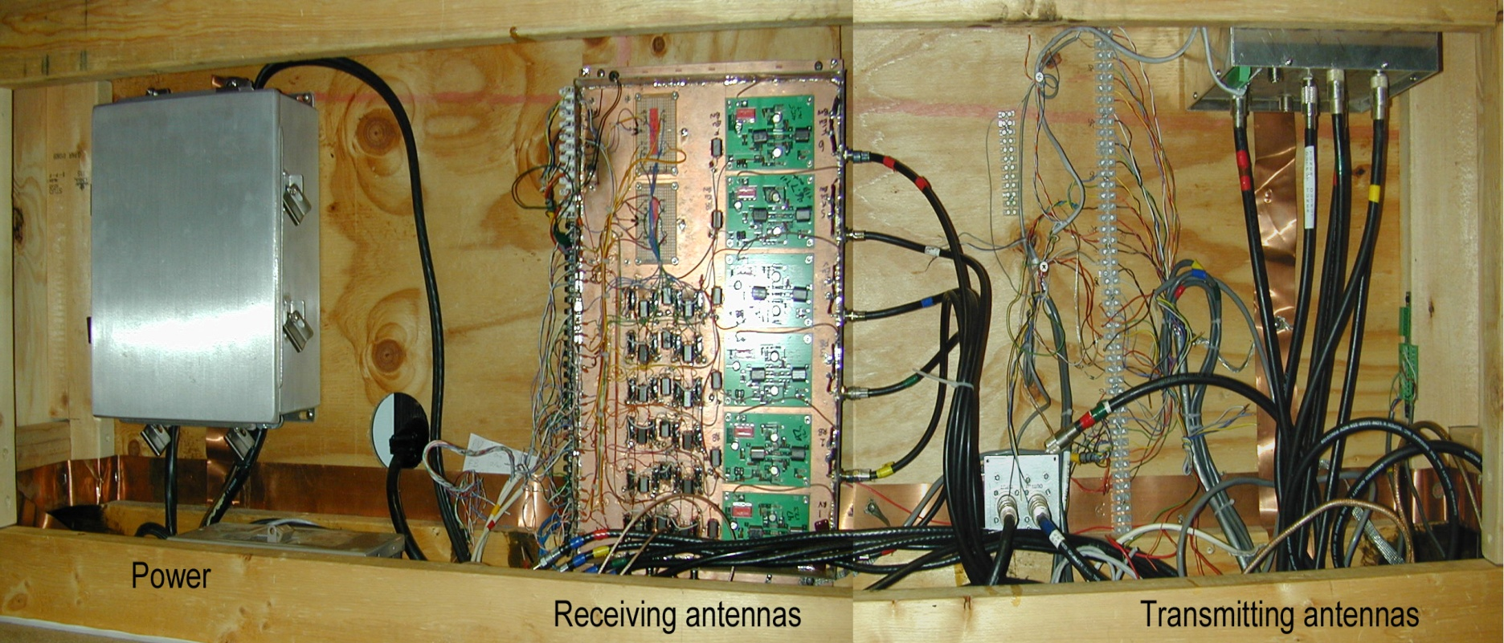
All power and all cables at “wire hider” All grounds are common

Slide 19
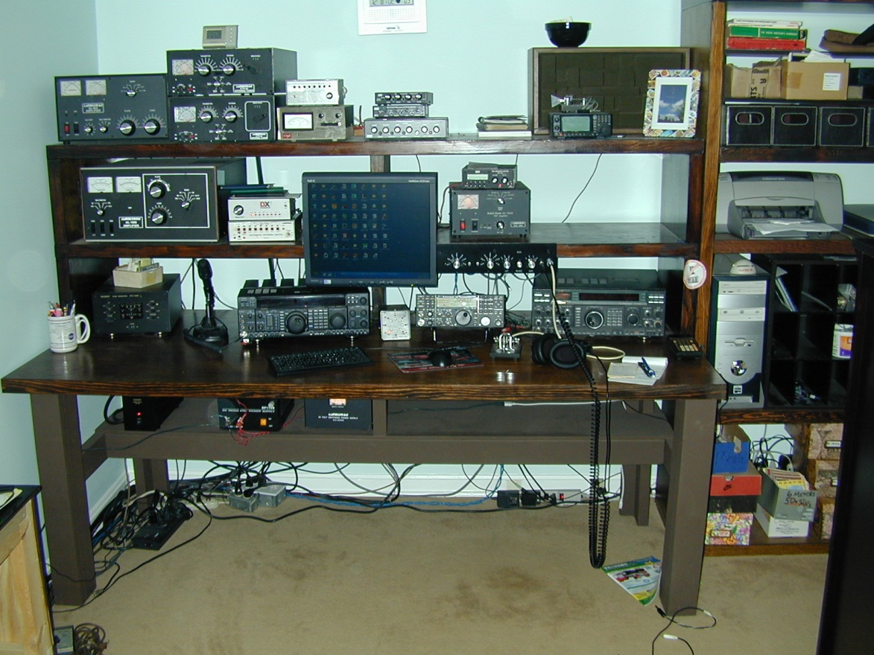
Every wire comes from wire hider!

Slide 20
I usually have one or more direct hits per storm
The only antennas protected by lightning arrestors are receiving antennas with 60-volt GDT tubes
DXE RR8HD and Ameritron RCS-8V’s protect TX lines when power is off
Control cables shielded and shields grounded
All cables arrive underground at buildings
  Never any damage in house
  Never disconnect cables

Slide 21

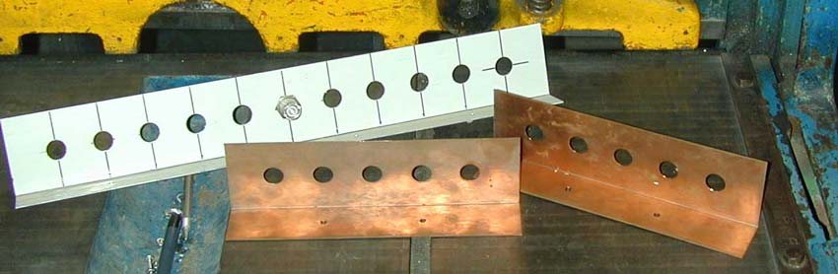
Homebrew Grounding Plates

Slide 22
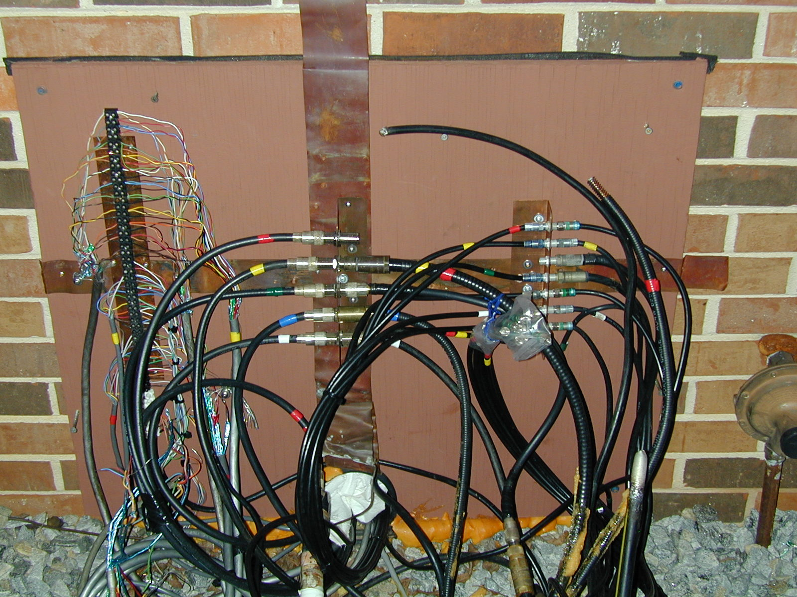
All cables common ground

Slide 23

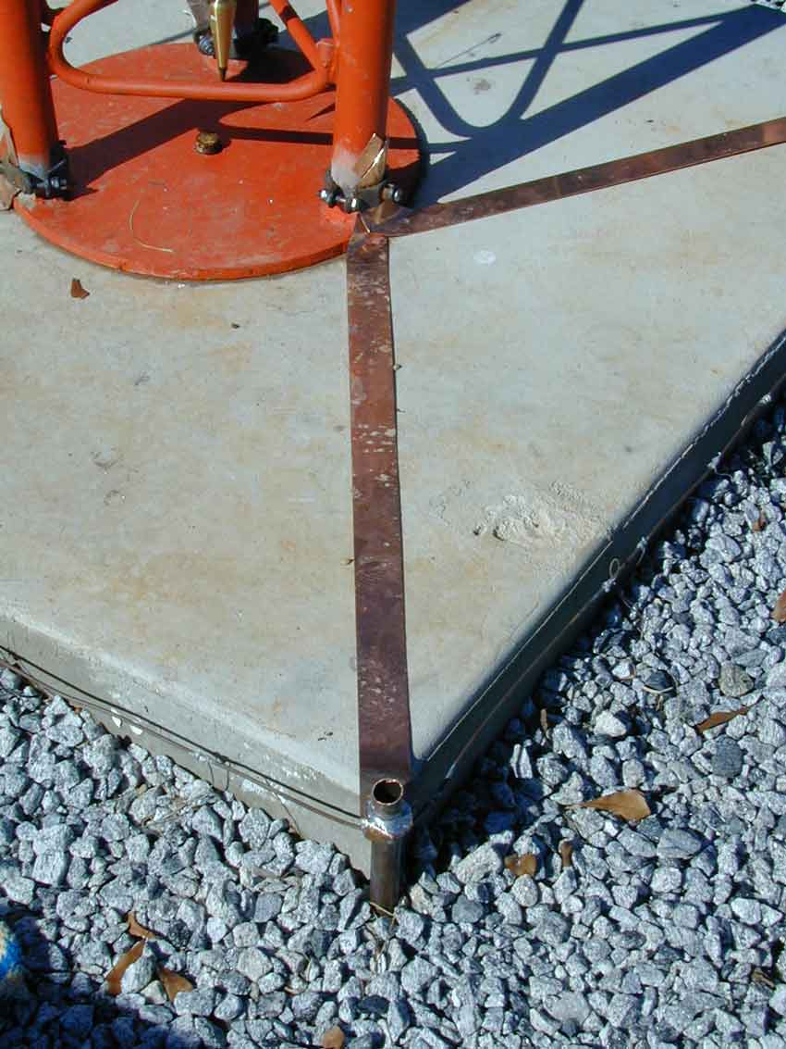
318 ft. tower ground
Eight #6 AWG deep buried radials
Fifty or so #16 shallow radials
Silver soldered connections

Slide 24
Tower Rules
Bring all cables to ground level
Bond cable shields to tower ground on tower
Do not attach conductive guy lines to buildings
Highest antenna most likely to take hits
Nothing will discourage a hit except another taller object nearby
If possible, use a good heavy radial ground with tall towers to spread energy out

Slide 25
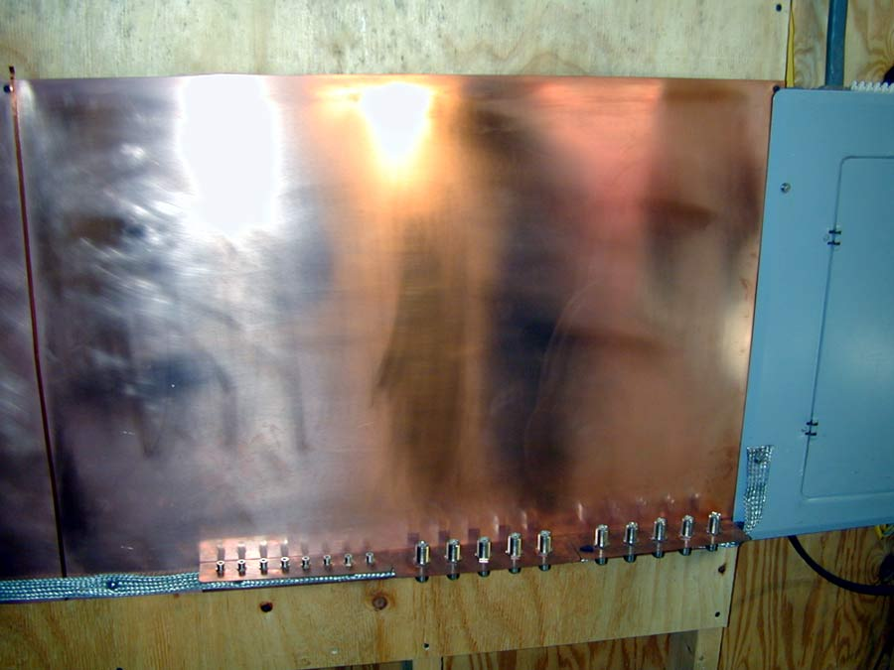
Most Important:
Always bond shack ground to powerline entrance ground
Best protection is to disconnect center conductors and have ground barrier on center
Use shielded control lines, or have low voltage MOV entrance block
All wires and cables entering shack have common ground point before going to desk

Slide 26
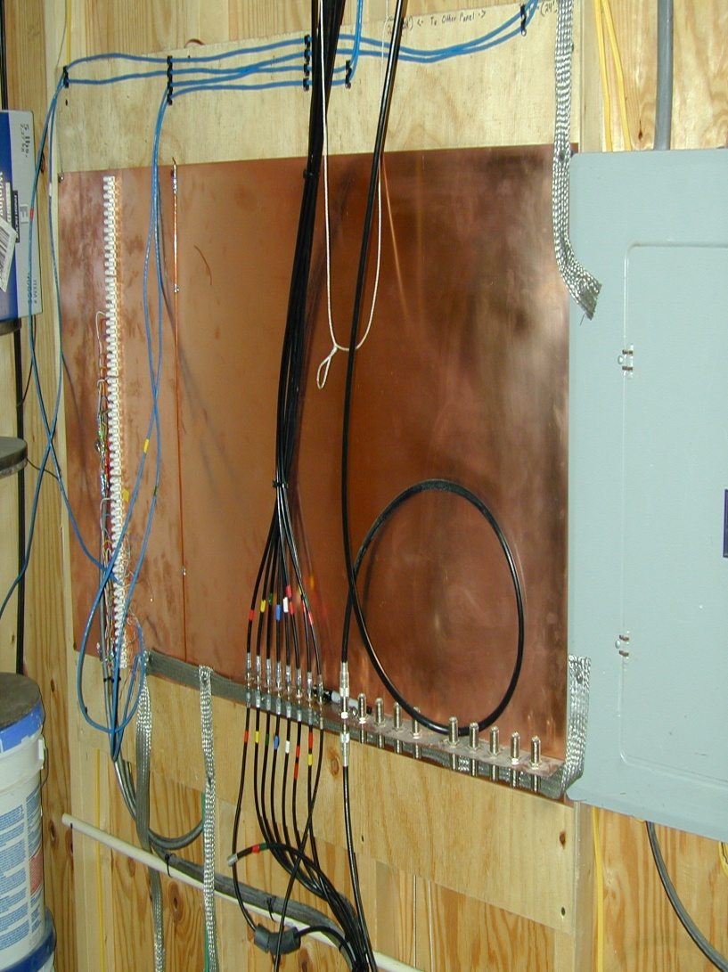
Contest barn entrance before wiring

Slide 27
end

